Slide 1
CoolLIFE Training Materials
Aadit Malla
TUW

Slide 2
Contents
CoolLIFE Tool intro and general Functionalities
CM: Space Cooling Demand
CM: Economic Feasibility
CM: District Cooling
Use Cases

Slide 3
CoolLIFE Tool intro and general Functionalities

Slide 4
Raster Layers for Cooling Needs
Parameter | Definition | Moderate Efficiency Scenario | High Efficiency Scenario
Shading Activation | Activation of the shading devices in the building facade | Manual or time controlled | Radiation dependent Control
Window Shading | Share of windows with shading | Lower shares of shading devices with shading | Higher shares of shading devices with shading
g-Value | Window solar transmittance | 3 pane thermal insulation glazing | Solar Control Glazing
Z factor | Shading reduction factor | Highly Reflective Inner Screen | External Venetian Blinds
Night Ventilation | Rates of Occupant inforced Night Ventilation | Low increase in ventilation rates | High increase in ventilation rates
Indoor Setpoint Temperature | Cooling set point temperature | Slight increase in set point temperature | Drastic increase in set point temperature
Thermal Capacity of building | Building Properties | Low | High

Slide 5
CM: Space Cooling Demand

Slide 6
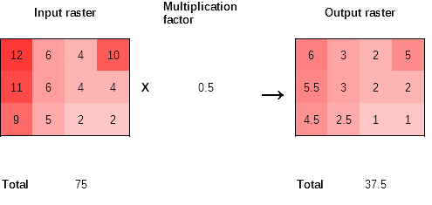
CM: Space Cooling Demand
Enables customization and modification of default layers
Enhances spatial visualization for different scenarios
Provides input data for other calculation modules (CMs)

Slide 7
CM: Economic Feasibility

Slide 8
Scenarios Passive Measures
Parameter | Definition | Moderate Efficiency Scenario | High Efficiency Scenario
Shading Activation | Activation of the shading devices in the building facade | Manual or time controlled | Radiation dependent Control
Window Shading | Share of windows with shading | Lower shares of shading devices with shading | Higher shares of shading devices with shading
g-Value | Window solar transmittance | 3 pane thermal insulation glazing | Solar Control Glazing
Z factor | Shading reduction factor | Highly Reflective Inner Screen | External Venetian Blinds
Night Ventilation | Rates of Occupant inforced Night Ventilation | Low increase in ventilation rates | High increase in ventilation rates
Indoor Setpoint Temperature | Cooling set point temperature | Slight increase in set point temperature | Drastic increase in set point temperature
Thermal Capacity of building | Building Properties | Low | High
Buildings selected for heating renovation take up passive measures
New buildings take up passive measures

Slide 9
Scenarios for Active Measures
Country-Specific Efficiency Improvement Scenarios
Average Baseline SEER per country
High: Baseline SEER +4
Moderate: Baseline SEER +2
Country-Specific Diffusion Scenarios

Slide 10
CM: District Cooling

Slide 11
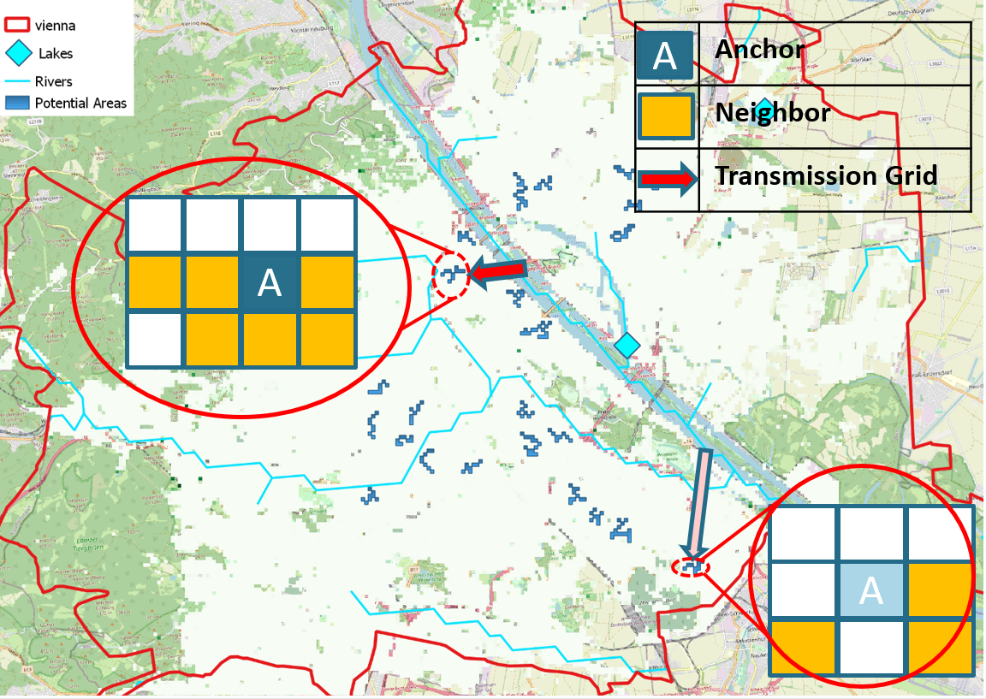

CM: District Cooling
Operates at a resolution of 100 × 100 meters
Identifies anchor points with consistently high demand
Determines areas where supply could be more cost-effective than conventional individual solutions under given conditions
Highly dependent on electricity prices
Input raster layers:
Gross Floor Area Total
Space Cooling Need
Gross Floor Area Non-Residential

Slide 12
Use Cases: How To Apply CoolLIFE tool

Slide 13
CoolLIFE tool: Use Cases
Use Cases | Target Users
Use Case 1: Strategic Planning for Energy Efficiency and Renewable Energy Integration | Civil society, energy cooperatives, technicians, planners, and policymakers.
Use Case 2: Reducing Energy Poverty and Ensuring Summer Comfort | Engineers, researchers, municipalities, NGOs, and civil society.
Use Case 3: Strategic and Building-Level Planning for Low-Carbon and Energy-Efficient Space Cooling | Public administrations, industry, policy makers, energy consultants, citizens, energy communities.
Use Case 4: Supporting Data-Driven Space Cooling Interventions for Technicians | Renewable energy communities, engineers, energy consultants.
Use Case 5: Behavioral Change for Energy Savings in Space Cooling | Public administrations, civil society.
Use Case 6: Integrating Space Cooling into Energy Communities | Civil society, citizens, public administrations.
Use Case 7: Provide inputs to the development of the National Comprehensive Assessment Report | National Energy Agency, policy makers, national regulatory bodies, and consultants supporting policy implementation.

Slide 14
Use Case 1:
How can space cooling be integrated into the broader energy efficiency sector to improve strategic decision-making at a regional scale, ensuring higher energy efficiency in residential buildings and better integration of renewable energy sources?
Assess energy use of decentralized cooling units
Consider efficiency improvements of supply units
Space Cooling demand
Technologies and Measures
Demand Side Management
Mapping Legal and regulatory information
Economic Feasibility
Adjust demand layers based on passive measure uptake
Define an accurate baseline for cooling interventions
Align cooling demand with renewable energy availability
Reduce peak loads through demand response strategies
Align cooling strategies with EU and national policies
Ensure compliance with regulatory frameworks
Space Cooling Demand Layers
District Cooling
Comfort Lifestyle and User Behaviour
Mapping Financial Instruments
Compare cooling intervention costs at different scales
Identify cost-effective measures for sustainable cooling
Establish baseline cooling demand and efficiency impact
Use default layers for scenario-based projections
Identify high-density cooling demand areas
Evaluate the feasibility of district cooling grids
Analyze cooling behavior and adaptive interventions
Promote behavioral interventions for demand reduction
Identify funding sources for cooling solutions
Explore public, private, and EU-level financial support
Supports informed policymaking
Evaluate demand, technology, costs, and management
Ensures alignment with energy efficiency and renewable goals

Slide 15
CoolLIFE tool: Use Cases
Use Cases | Target Users
Use Case 1: Strategic Planning for Energy Efficiency and Renewable Energy Integration | Civil society, energy cooperatives, technicians, planners, and policymakers.
Use Case 2: Reducing Energy Poverty and Ensuring Summer Comfort | Engineers, researchers, municipalities, NGOs, and civil society.
Use Case 3: Strategic and Building-Level Planning for Low-Carbon and Energy-Efficient Space Cooling | Public administrations, industry, policy makers, energy consultants, citizens, energy communities.
Use Case 4: Supporting Data-Driven Space Cooling Interventions for Technicians | Renewable energy communities, engineers, energy consultants.
Use Case 5: Behavioral Change for Energy Savings in Space Cooling | Public administrations, civil society.
Use Case 6: Integrating Space Cooling into Energy Communities | Civil society, citizens, public administrations.
Use Case 7: Provide inputs to the development of the National Comprehensive Assessment Report | National Energy Agency, policy makers, national regulatory bodies, and consultants supporting policy implementation.

Slide 16
Use Case 2:
How can space cooling interventions be designed and implemented to reduce energy poverty while ensuring equitable access to summer comfort for all households, particularly in vulnerable communities?
Map policies affecting cooling affordability and access
Identify regulatory barriers and opportunities for equitable solutions
Mapping Legal and regulatory information
Economic Feasibility
Comfort Lifestyle and User Behaviour
Identify funding mechanisms (grants, subsidies, low-interest loans)
Facilitate adoption of efficient cooling technologies for low-income groups
Address financial barriers to ensure widespread cooling access
Assess affordability of cooling solutions for low-income households
Compare passive and active technologies to identify cost-effective options
Support policy design for financial aid and equitable cooling access
Mapping Financial Instruments
Analyze household cooling behaviors and adaptive practices
Design awareness programs for efficient cooling habits
Combining economic, behavioral, regulatory, and financial assessments ensures targeted and cost-effective cooling solutions.
Supports long-term access to sustainable cooling for vulnerable communities without increasing financial burdens.

Slide 17
CoolLIFE tool: Use Cases
Use Cases | Target Users
Use Case 1: Strategic Planning for Energy Efficiency and Renewable Energy Integration | Civil society, energy cooperatives, technicians, planners, and policymakers.
Use Case 2: Reducing Energy Poverty and Ensuring Summer Comfort | Engineers, researchers, municipalities, NGOs, and civil society.
Use Case 3: Strategic and Building-Level Planning for Low-Carbon and Energy-Efficient Space Cooling | Public administrations, industry, policy makers, energy consultants, citizens, energy communities.
Use Case 4: Supporting Data-Driven Space Cooling Interventions for Technicians | Renewable energy communities, engineers, energy consultants.
Use Case 5: Behavioral Change for Energy Savings in Space Cooling | Public administrations, civil society.
Use Case 6: Integrating Space Cooling into Energy Communities | Civil society, citizens, public administrations.
Use Case 7: Provide inputs to the development of the National Comprehensive Assessment Report | National Energy Agency, policy makers, national regulatory bodies, and consultants supporting policy implementation.

Slide 18
Use Case 3:
How can space cooling interventions be scaled beyond individual buildings to a strategic, low-carbon planning approach that aligns with long-term energy and climate targets?
How can space cooling interventions at the building scale be optimized to reduce energy consumption while ensuring economic feasibility and regulatory compliance?
Optimize cooling technology adoption for large-scale planning.
Improve efficiency to reduce building-level cooling demand.
Technologies and Measures
Demand Side Management
Mapping Legal and regulatory information
Economic Feasibility
Align cooling demand with renewable energy.
Optimize PV self-consumption and load shifting.
Ensure compliance with national/EU regulations.
Leverage policies for efficient cooling adoption.
District Cooling
Comfort Lifestyle and User Behaviour
Mapping Financial Instruments
Compare cooling costs for large-scale planning.
Ensure financial viability of building-level solutions.
Integrate user behavior into cooling strategies.
Promote adaptive cooling for energy savings.
Secure funding for large-scale cooling projects.
Support building-level efficiency with financial aid.
Identify high-demand areas for district cooling.
Assess building connections for cost-effective cooling.
Develop data-driven cooling strategies for regional and building scales.
Ensure economic, regulatory, and technological feasibility of interventions.
Support sustainable, energy-efficient cooling at all levels.

Slide 19
CoolLIFE tool: Use Cases
Use Cases | Target Users
Use Case 1: Strategic Planning for Energy Efficiency and Renewable Energy Integration | Civil society, energy cooperatives, technicians, planners, and policymakers.
Use Case 2: Reducing Energy Poverty and Ensuring Summer Comfort | Engineers, researchers, municipalities, NGOs, and civil society.
Use Case 3: Strategic and Building-Level Planning for Low-Carbon and Energy-Efficient Space Cooling | Public administrations, industry, policy makers, energy consultants, citizens, energy communities.
Use Case 4: Supporting Data-Driven Space Cooling Interventions for Technicians | Renewable energy communities, engineers, energy consultants.
Use Case 5: Behavioral Change for Energy Savings in Space Cooling | Public administrations, civil society.
Use Case 6: Integrating Space Cooling into Energy Communities | Civil society, citizens, public administrations.
Use Case 7: Provide inputs to the development of the National Comprehensive Assessment Report | National Energy Agency, policy makers, national regulatory bodies, and consultants supporting policy implementation.

Slide 20
Use Case 4:
How can space cooling data be utilized to support engineers and energy consultants in designing effective cooling interventions based on building energy consumption and demand patterns?
Estimate cooling energy use based on climate and system efficiency.
Assess demand scenarios for technology adoption and efficiency gains.
Technologies and Measures
Economic Feasibility
Demand Side Management
Align cooling demand with renewable energy generation.
Optimize PV self-consumption and demand response.
District Cooling
Compare the costs of passive and active cooling solutions.
Assess financial viability for cost-effective interventions.
Identify high-demand areas for district cooling feasibility.
Evaluate grid potential to improve efficiency and cut costs.
Use data-driven methods to design efficient cooling interventions.
Ensure cost-effective, sustainable cooling through technology and demand-side strategies.
Support the transition to energy-efficient and renewable-based cooling solutions.

Slide 21
CoolLIFE tool: Use Cases
Use Cases | Target Users
Use Case 1: Strategic Planning for Energy Efficiency and Renewable Energy Integration | Civil society, energy cooperatives, technicians, planners, and policymakers.
Use Case 2: Reducing Energy Poverty and Ensuring Summer Comfort | Engineers, researchers, municipalities, NGOs, and civil society.
Use Case 3: Strategic and Building-Level Planning for Low-Carbon and Energy-Efficient Space Cooling | Public administrations, industry, policy makers, energy consultants, citizens, energy communities.
Use Case 4: Supporting Data-Driven Space Cooling Interventions for Technicians | Renewable energy communities, engineers, energy consultants.
Use Case 5: Behavioral Change for Energy Savings in Space Cooling | Public administrations, civil society.
Use Case 6: Integrating Space Cooling into Energy Communities | Civil society, citizens, public administrations.
Use Case 7: Provide inputs to the development of the National Comprehensive Assessment Report | National Energy Agency, policy makers, national regulatory bodies, and consultants supporting policy implementation.

Slide 22
Use Case 5:
How can behavioral changes and adaptive cooling practices contribute to reducing energy consumption in public and private buildings, and how can they be effectively integrated into space cooling strategies?
Align cooling demand with renewable energy.
Promote pre-cooling and load reduction strategies.
Demand Side Management
Mapping Legal and regulatory information
Enforce policies for energy-efficient cooling.
Use building codes to support demand-side measures.
Analyze cooling habits to optimize energy use.
Encourage natural ventilation, shading, and setpoint adjustments.
Comfort Lifestyle and User Behaviour
Mapping Financial Instruments
Provide incentives for efficient cooling and awareness programs.
Support energy-saving habits with grants and subsidies.
Promote behavioral change and demand-side flexibility to reduce cooling energy use.
Align policies and financial incentives to support energy-efficient cooling practices.
Ensure long-term sustainability in public and private buildings.

Slide 23
CoolLIFE tool: Use Cases
Use Cases | Target Users
Use Case 1: Strategic Planning for Energy Efficiency and Renewable Energy Integration | Civil society, energy cooperatives, technicians, planners, and policymakers.
Use Case 2: Reducing Energy Poverty and Ensuring Summer Comfort | Engineers, researchers, municipalities, NGOs, and civil society.
Use Case 3: Strategic and Building-Level Planning for Low-Carbon and Energy-Efficient Space Cooling | Public administrations, industry, policy makers, energy consultants, citizens, energy communities.
Use Case 4: Supporting Data-Driven Space Cooling Interventions for Technicians | Renewable energy communities, engineers, energy consultants.
Use Case 5: Behavioral Change for Energy Savings in Space Cooling | Public administrations, civil society.
Use Case 6: Integrating Space Cooling into Energy Communities | Civil society, citizens, public administrations.
Use Case 7: Provide inputs to the development of the National Comprehensive Assessment Report | National Energy Agency, policy makers, national regulatory bodies, and consultants supporting policy implementation.

Slide 24
Use Case 6:
How can space cooling be integrated into energy communities to enhance collective energy management, improve energy efficiency, and ensure shared benefits for participants?
Demand Side Management
Mapping Legal and regulatory information
Align shared cooling solutions with EU and national policies.
Identify regulatory barriers and opportunities for implementation.
Economic Feasibility
Shift cooling loads to match renewable energy generation.
Use load balancing and peak demand reduction for efficiency.
Comfort Lifestyle and User Behaviour
Mapping Financial Instruments
Secure funding through subsidies, grants, and EU programs.
Support energy-efficient cooling investments in communities.
Compare the costs of passive and active cooling for energy communities.
Ensure shared investments lead to financial and efficiency benefits.
Analyze community cooling demand and behavioral patterns.
Promote shared cooling and adaptive practices to optimize use.
Integrate space cooling into energy communities for collective energy efficiency.
Assess economic, behavioral, and regulatory factors to ensure feasibility.
Leverage financial support and demand-side flexibility for shared benefits.

Slide 25
CoolLIFE tool: Use Cases
Use Cases | Target Users
Use Case 1: Strategic Planning for Energy Efficiency and Renewable Energy Integration | Civil society, energy cooperatives, technicians, planners, and policymakers.
Use Case 2: Reducing Energy Poverty and Ensuring Summer Comfort | Engineers, researchers, municipalities, NGOs, and civil society.
Use Case 3: Strategic and Building-Level Planning for Low-Carbon and Energy-Efficient Space Cooling | Public administrations, industry, policy makers, energy consultants, citizens, energy communities.
Use Case 4: Supporting Data-Driven Space Cooling Interventions for Technicians | Renewable energy communities, engineers, energy consultants.
Use Case 5: Behavioral Change for Energy Savings in Space Cooling | Public administrations, civil society.
Use Case 6: Integrating Space Cooling into Energy Communities | Civil society, citizens, public administrations.
Use Case 7: Provide inputs to the development of the National Comprehensive Assessment Report | National Energy Agency, policy makers, national regulatory bodies, and consultants supporting policy implementation.

Slide 26
Use Case 7:
How can national-level assessments of space cooling, as required by the Energy Efficiency Directive (EED), support the identification of cost-effective efficiency measures, promote the integration of district cooling, and align with long-term decarbonization and energy security targets?
Requirements of EED:
Data Collection: Mapping cooling demand and defining system boundaries.
Technical Potential: Assessing efficient cooling solutions
Scenarios Development: Establishing baseline demand and alternative efficiency scenarios.
Cost-Benefit Analysis (CBA): Evaluating financial, environmental, and health benefits of cooling measures.
Optimal Solutions: Identifying the most cost-effective and energy-efficient cooling strategies.
Economic Feasibility

